Slide 1
Return attribution
October 2024
Charlie Nash
Head of QRA
Alan Cubbon
Head of Research

Slide 2
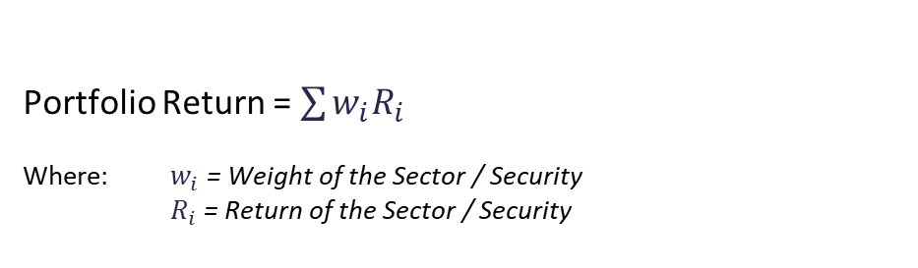
Return Contribution analysis
Known as absolute return attribution analysis as it is not calculated relative to a benchmark
Portfolio Return = $\sum{w_{i}R_{i}}$
Where: $w_{i}$ = Weight of the Sector / Security
$R_{i}$ = Return of the Sector / Security
Example:
 | Weight % | Return % | Contribution %
Security A | 25 | 4.80 | 1.20
Security B | 50 | 2.50 | 1.25
Security C | 25 | -1.20 | -0.30
Portfolio Total | 100 | 2.15 | 2.15
Source: CAIM, October 2024

Slide 3
Attribution Analysis
Quantify the portfolio managers active decision to explain the difference between the portfolio and benchmark return
Allocation = Refers to the value the Portfolio Manager adds by having different sector weights
Selection = Refers to the value the Portfolio Manager adds by holding individual securities within the sector
Sector | Portfolio weight % | Portfolio return % | Benchmark weight % | Benchmark return % | Allocation % | Selection %
Government | 50 | 18 | 50 | 10 | 0.0 | 4.0
Financial | 30 | -3 | 20 | -2 | -1.02 | -0.3
Cash | 20 | 10 | 30 | 12 | 0.38 | -0.4
Portfolio Total | 100 | 10.1 | 100 | 8.2 | -1.40 | 3.3
What does this tell us?
Overall the fund outperformed the benchmark by 1.9%
The portfolio is overweight financials and underweight cash (10%)
Being overweight financials cost 1%, and selection within financials also had a negative effect.
Being neutral government had no effect, but the selection within this sector had a strongly positive effect
Source: CAIM, October 2024

Slide 4
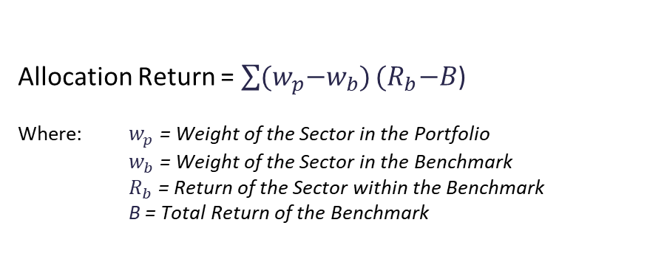
Attribution Analysis
Allocation Calculation
Allocation Return = $\sum{{(w}_{p}−w_{b})}{(R}_{b}−B$)
Where: $w_{p}$ = Weight of the Sector in the Portfolio
$w_{b}$ = Weight of the Sector in the Benchmark
$R_{b}$ = Return of the Sector within the Benchmark
B = Total Return of the Benchmark
Calculation:
Sector | Portfolio weight % | Portfolio return % | Benchmark weight % | Benchmark return % | Allocation %
Government | 50 | 18 | 50 | 10 | (50 – 50) x (10 – 8.2) = 0.0
Financial | 30 | -3 | 20 | -2 | (30 – 20) x (-2 – 8.2) = -1.0
Cash | 20 | 10 | 30 | 12 | (20 – 30) x (12 – 8.2) = -0.4
Portfolio Total | 100 | 10.1 | 100 | 8.2 | 0.0 + -1.0 + -0.4 = -1.4
Source: CAIM, October 2024

Slide 5
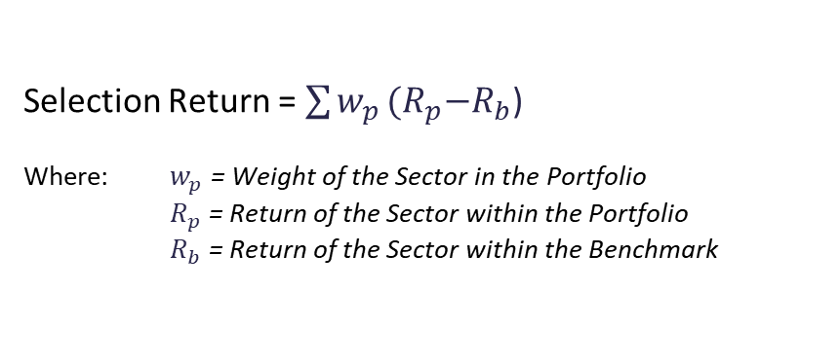
Attribution Analysis
Selection Calculation
Selection Return = $\sum{w_{p}}{(R}_{p}−R_{b}$)
Where: $w_{p}$ = Weight of the Sector in the Portfolio
$R_{p}$ = Return of the Sector within the Portfolio
$R_{b}$ = Return of the Sector within the Benchmark
Calculation:
Sector | Portfolio weight % | Portfolio return % | Benchmark weight % | Benchmark return % | Selection %
Government | 50 | 18 | 50 | 10 | 50 x (18 – 10) = 4.0
Financial | 30 | -3 | 20 | -2 | 30 x (-3 – -2) = -0.3
Cash | 20 | 10 | 30 | 12 | 20 x (10 – 12) = -0.4
Portfolio Total | 100 | 10.1 | 100 | 8.2 | 4.0 + -0.3 + -0.4 = 3.3
Source: CAIM, October 2024

Slide 6
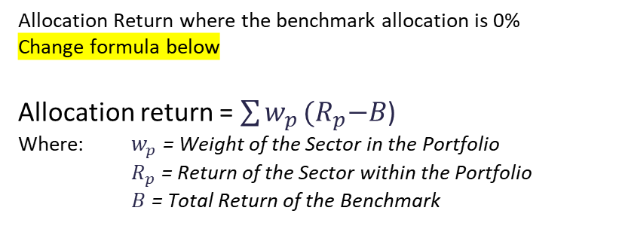
Attribution Analysis – Off Benchmark Bets
Allocation Calculation – for sectors not included in the benchmark
Allocation Return where the benchmark allocation is 0%
Change formula below
Allocation return = $\sum{w_{p}}{(R}_{p}−B$)
Where: $w_{p}$ = Weight of the Sector in the Portfolio
$R_{p}$ = Return of the Sector within the Portfolio
$B$ = Total Return of the Benchmark
Calculation:
Sector | Portfolio weight % | Portfolio return % | Benchmark weight % | Benchmark return % | Allocation %
Government | 50 | 18 | 50 | 10 | (50 – 50) x (10 – 8.2) = 0.0
Financial | 25 | -3 | 20 | -2 | (25 – 20) x (-2 – 8.2) = -0.5
Transportation | 5 | 4 | - | - | (5) X (4 – 8.2) = -0.2
Cash | 20 | 10 | 30 | 12 | (20 – 30) x (12 – 8.2) = -0.4
Portfolio Total | 100 | 10.5 | 100 | 8.2 | 0.0 + -0.5 + -0.2 + -0.4 = -1.1
Source: CAIM, October 2024

Slide 7
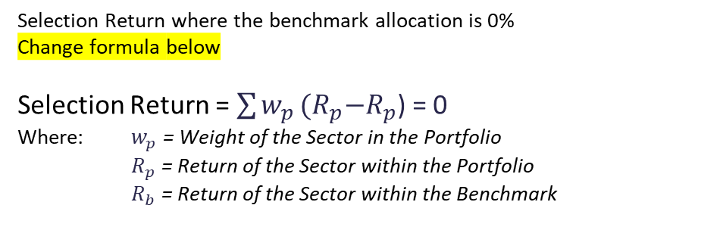
Attribution Analysis – Off Benchmark Bets
Selection Calculation – for sectors not included in the benchmark = 0
Selection Return where the benchmark allocation is 0%
Change formula below
Selection Return = $\sum{w_{p}}{(R}_{p}−R_{p}$) = 0
Where: $w_{p}$ = Weight of the Sector in the Portfolio
$R_{p}$ = Return of the Sector within the Portfolio
$R_{b}$ = Return of the Sector within the Benchmark
Calculation:
Sector | Portfolio weight % | Portfolio return % | Benchmark weight % | Benchmark return % | Selection %
Government | 50 | 18 | 50 | 10 | 50 x (18 – 10) = 4.0
Financial | 25 | -3 | 20 | -2 | 25 x (-3 – -2) = -0.25
Transportation | 5 | 4 | - | - | 5 x (4 – 4) = 0
Cash | 20 | 10 | 30 | 12 | 20 x (10 – 12) = -0.4
Portfolio Total | 100 | 10.5 | 100 | 8.2 | 4.0 + -0.3 + 0 + -0.4 = 3.4
Alpha = 10.5% - 8.2% = 2.3%
Allocation + Selection = -1.1% + 3.4% = 2.3% (correct)
Source: CAIM, October 2024

Slide 8
Attribution Analysis – another example
Analysis by maturity bucket
Maturity | Portfolio weight % | Portfolio return % | Benchmark weight % | Benchmark return % | Allocation % | Selection %
0 – 1 Year | 20 | 0.15 | 20 | 0.14 | 0.00 | 0.00
1 – 3 Years | 50 | 1.65 | 30 | 1.55 | -0.08 | 0.05
4 – 9 Years | 20 | 2.80 | 30 | 2.75 | -0.08 | 0.01
10+ Years | 10 | 3.35 | 20 | 3.25 | -0.13 | 0.01
Total | 100 | 1.75 | 100 | 1.97 | -0.29 | 0.07
Portfolio manager decisions:
Overweighting of shorter maturity segments of the yield curve.
Evident in the overweighting of the 1-3 year bucket vs 4-9 years and 10+ years.
Anticipation of interest rate rise across maturities.
Underweight longer maturities would have limit loss in the rise.
Analysis suggests manager was incorrect in underweighting as allocation for buckets over 1 year are attributing to the overall loss.
Allocation covers yield curve positioning, Selection covers all other decisions.
Source: CAIM, October 2024

